Slide 1
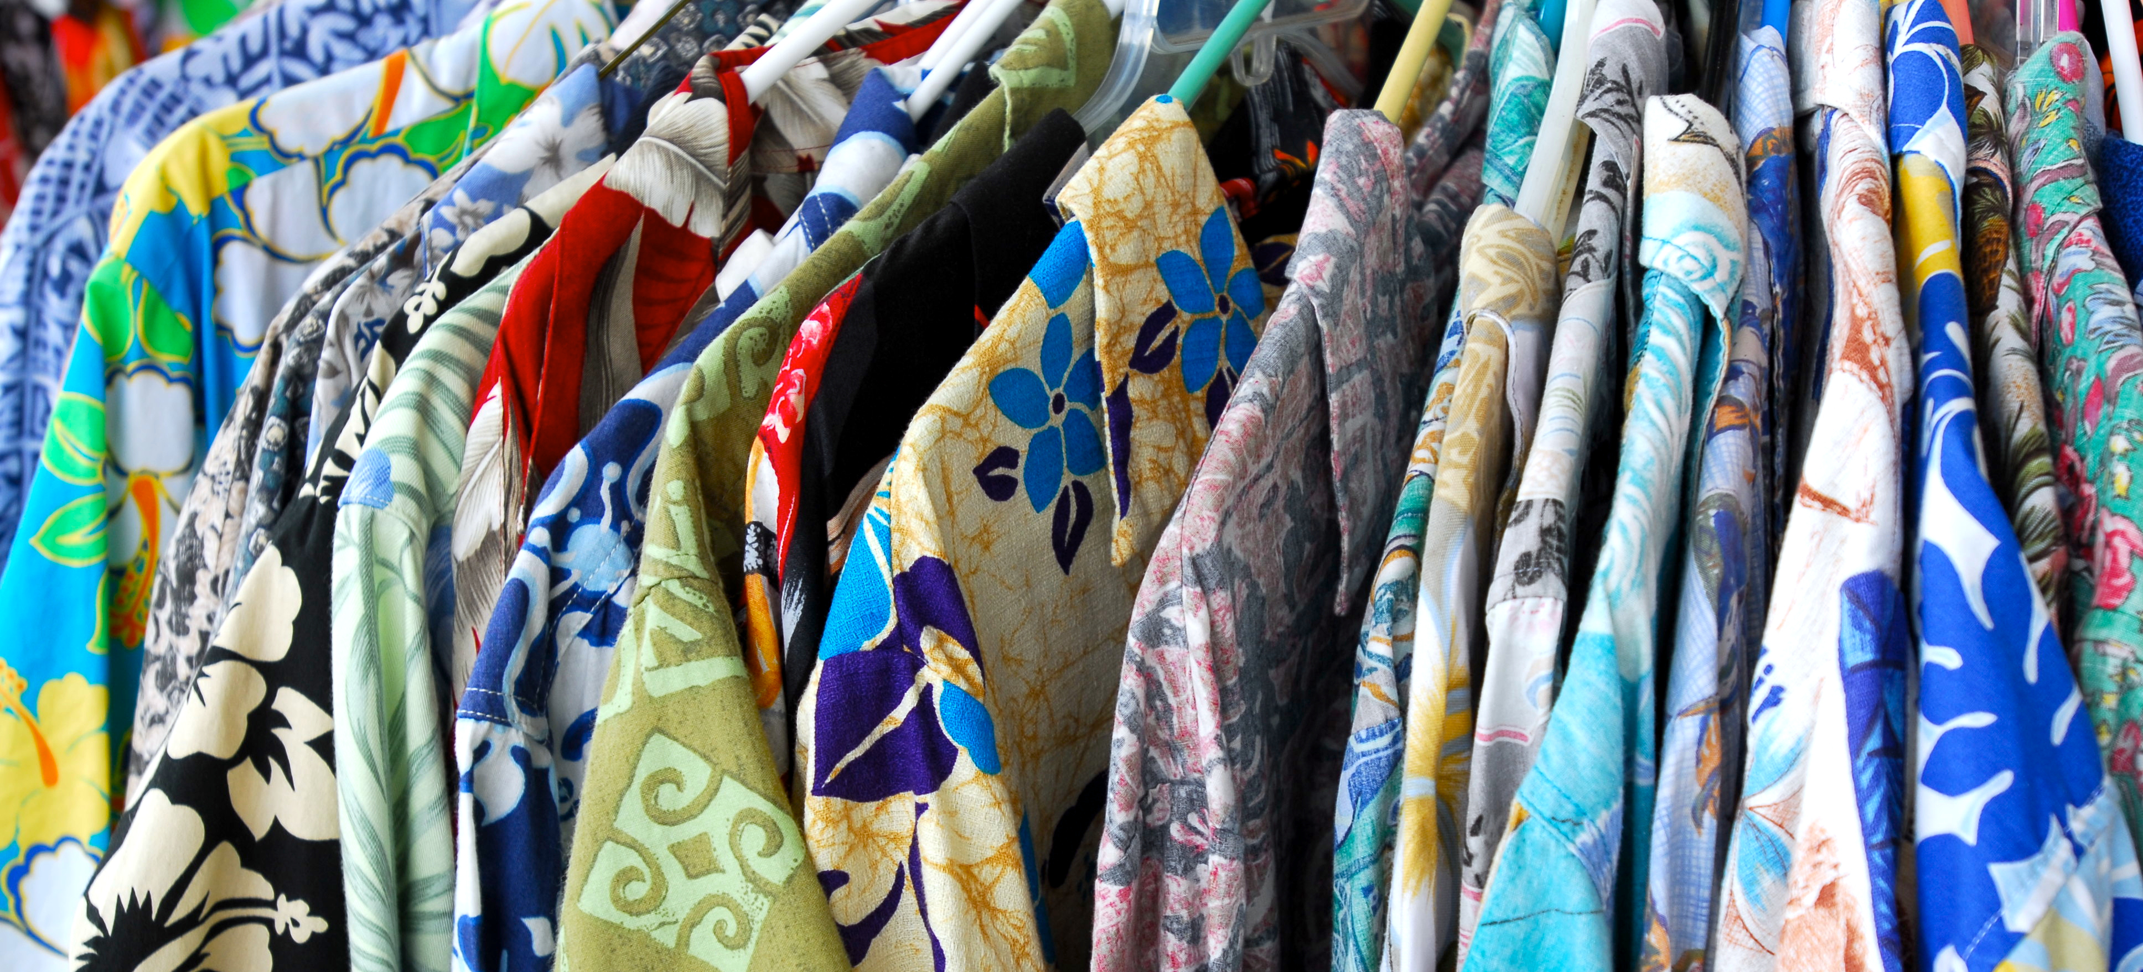
The Voice of DBEDT Made in Hawai‘i Branding Workshop Attendees on Strategic Priorities
Prepared for the:
DBEDT Made in Hawai‘i Branding Workshop Workshop Held on March 29, 2023
Hawai‘i Convention Center, Honolulu
Davies Pacific Center 1250, 841 Bishop Street, Honolulu, Hawai‘i 96813
Telephone: 1-808-528-4050 omnitrak@omnitrakgroup.com

Slide 2
Q1) Going forward, should the Made in Hawai‘i brand be primarily positioned as…?
A lifestyle brand to promote Hawai‘i’s diverse products (e.g., travel, fashion, food etc.) to consumers with an affinity for Hawai‘i regardless of whether or not they travel here
A destination brand to attract visitors to Hawai‘i and to sell them Hawai‘i products during their visit and after
Don’t know
Source: DBEDT Made in Hawai‘i Branding Workshop InstaPoll to 250 attendees

Slide 3
Q2) In implementing Made in Hawai‘i, which approach do you feel will better break through the noise and strengthen the emotional connection between the Hawai‘i brand and potential buyers:
A consistent umbrella Hawai‘i brand image, personality and expression to convey what Hawai‘i stands for
Different brand images, personalities and expressions for different products and geographies
Don’t know
Source: DBEDT Made in Hawai‘i Branding Workshop InstaPoll to 250 attendees

Slide 4
Q3) Currently, Made in Hawai‘i is defined as 51% of a product’s content must be sourced in Hawai‘i. A bill was introduced in the Legislature that would change that to 51% of operating costs including labor, rent, research and development, etc., not just the product content, must be sourced in Hawai‘i to claim “Made in Hawai‘i.” On a scale of 1 to 10, how much do you favor or oppose expanding the 51% requirement to include operating and overhead costs?
17% Oppose
74% Favor
Ratings (6-10)
Don’t Know
10%
Bottom Box
(1-5)
Mid Box
(6-8)
Top Box
(9-10)
Source: DBEDT Made in Hawai‘i Branding Workshop InstaPoll to 250 Attendees

